Slide 1

Exploratory Data Analysis: COVID-19 Spatial Data
Stephen Chong Zhao
Oct. 31st, 2023

Slide 2

Introduction
Topic: COVID-19 Pandemic
Dataset: WHO COVID-19 Data
Motivations:
Which countries have been affected by COVID-19 the most (at a given day)?
Do countries report new cases everyday?
Is there a direct correlation between severity of the pandemic and population (size/density)?

Slide 3

Data Description
Source: World Health Organization (WHO)
Timeliness: Updated daily since January 3rd, 2020
Cut-off date: October 25th, 2023
Important Features:
Country/Region Names
Total Cumulative Cases/Deaths
Daily New Cases/Deaths
Report Dates
Population estimates and area of region
Merged from Geopandas “Natural Earth” dataset

Slide 4

Exploratory Analysis

Slide 5
Top 10 Countries: Cumulative Cases & Population Density
Countries with the Most Cumulative Cases
 | Country | Cumulative Cases Total
0 | Global | 771549718
1 | United States of America | 103436829
2 | China | 99316932
3 | India | 45001052
4 | France | 38997490
5 | Germany | 38437756
6 | Brazil | 37721749
7 | Republic of Korea | 34571873
8 | Japan | 33803572
9 | Italy | 26202253
10 | The United Kingdom | 24789488
Countries with Highest Infection Rate
 | Country | Infection Rate (Cum. Cases/100k)
1 | Cyprus | 74420.076
2 | San Marino | 72770.935
3 | Brunei Darussalam | 71339.196
4 | Faroe Islands | 70926.021
5 | Austria | 68320.900
6 | Republic of Korea | 67432.071
7 | Slovenia | 64192.425
8 | Andorra | 62143.273
9 | Jersey | 61589.484
10 | Luxembourg | 61391.645

Slide 6
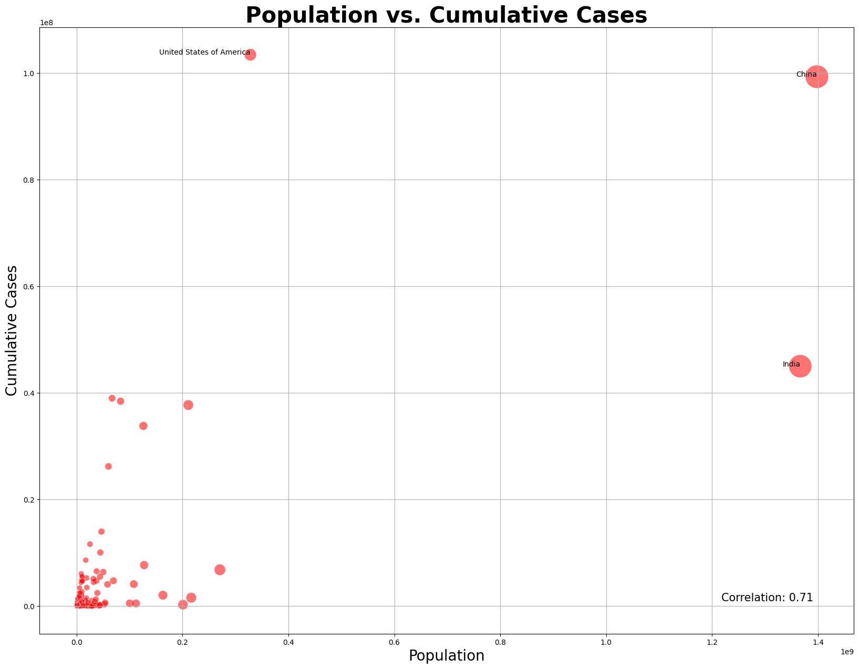
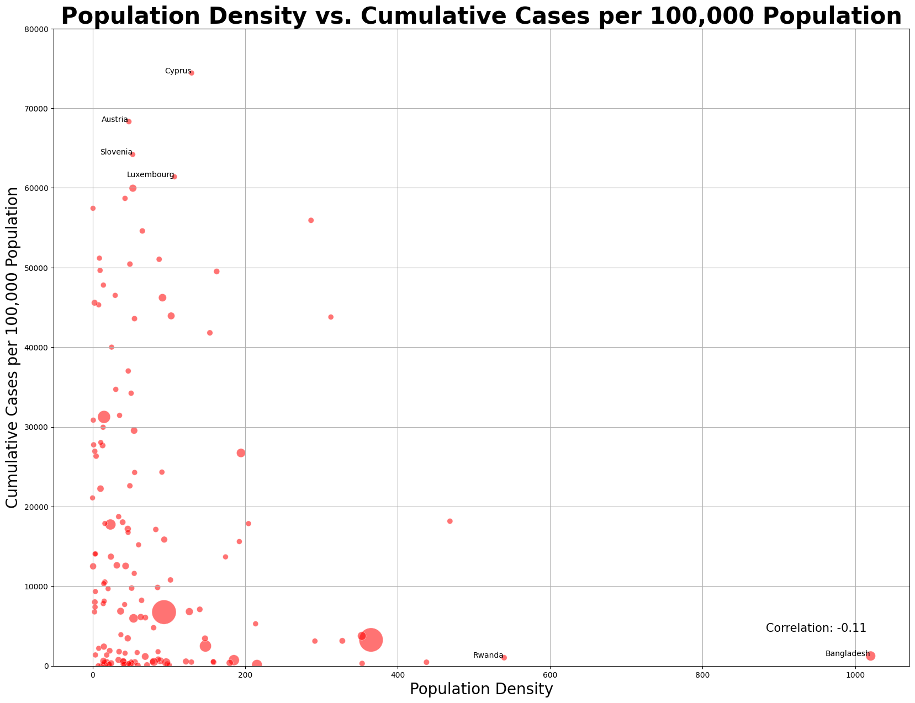
Population & Cases
Positive correlation population size and total cumulative cases within a country
No strong correlation between population density and Infection Rate within a country

Slide 7
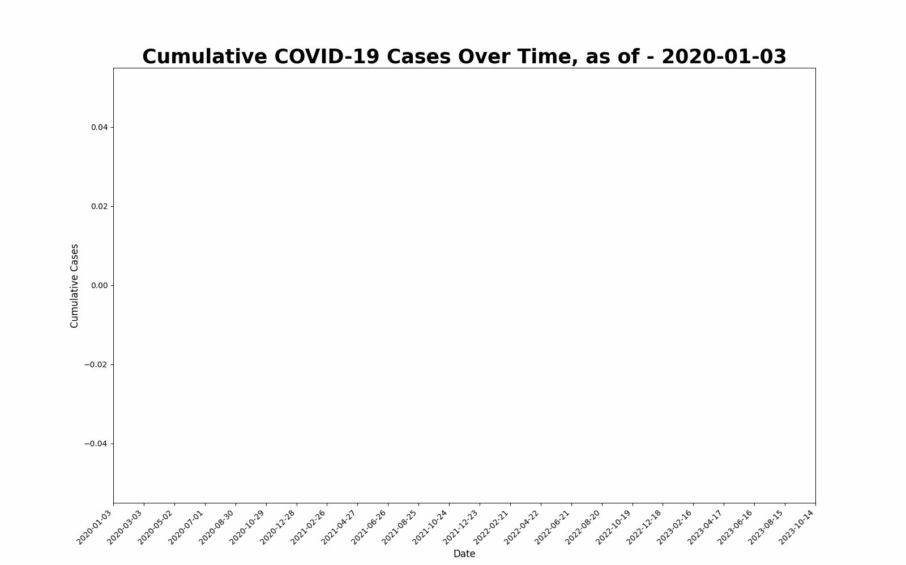
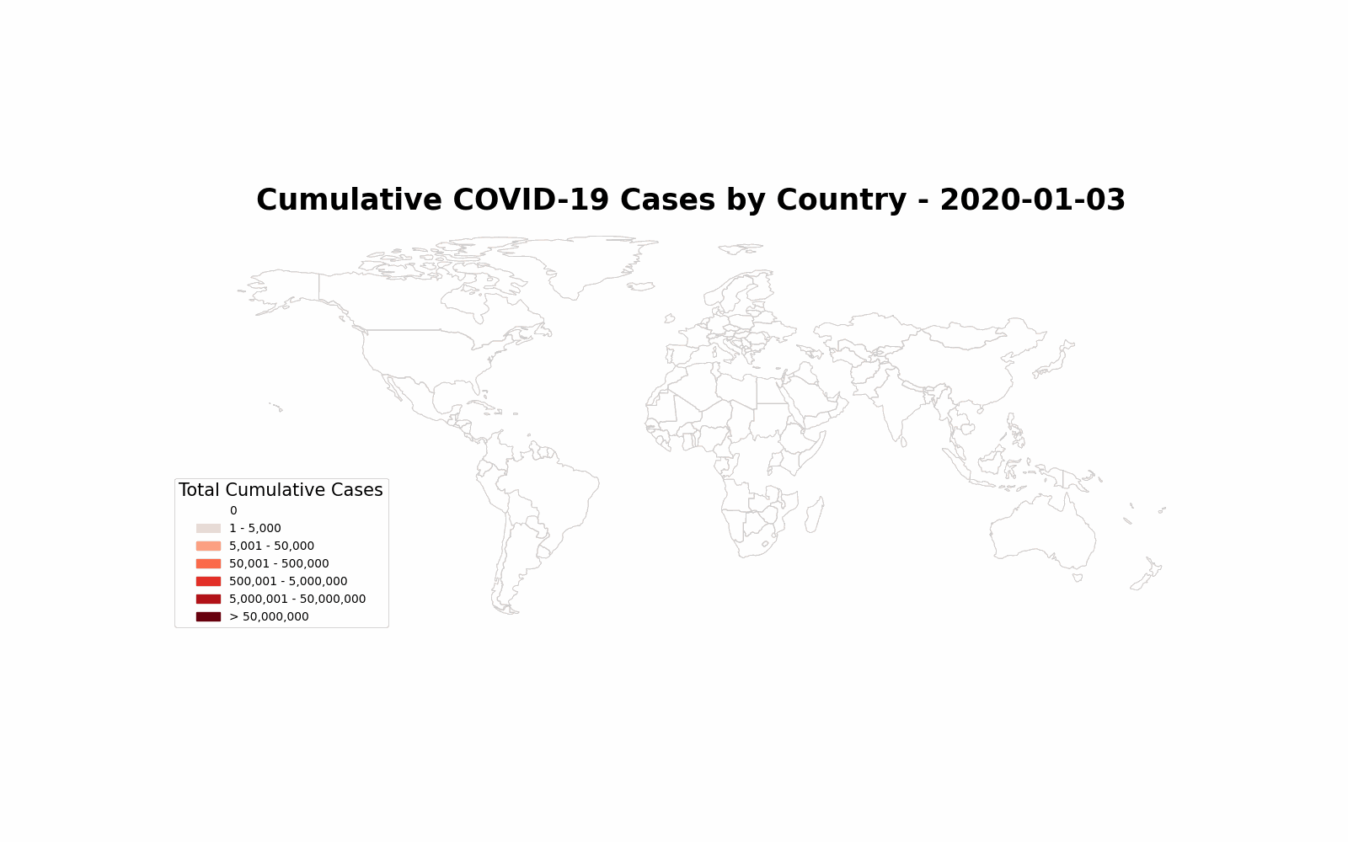
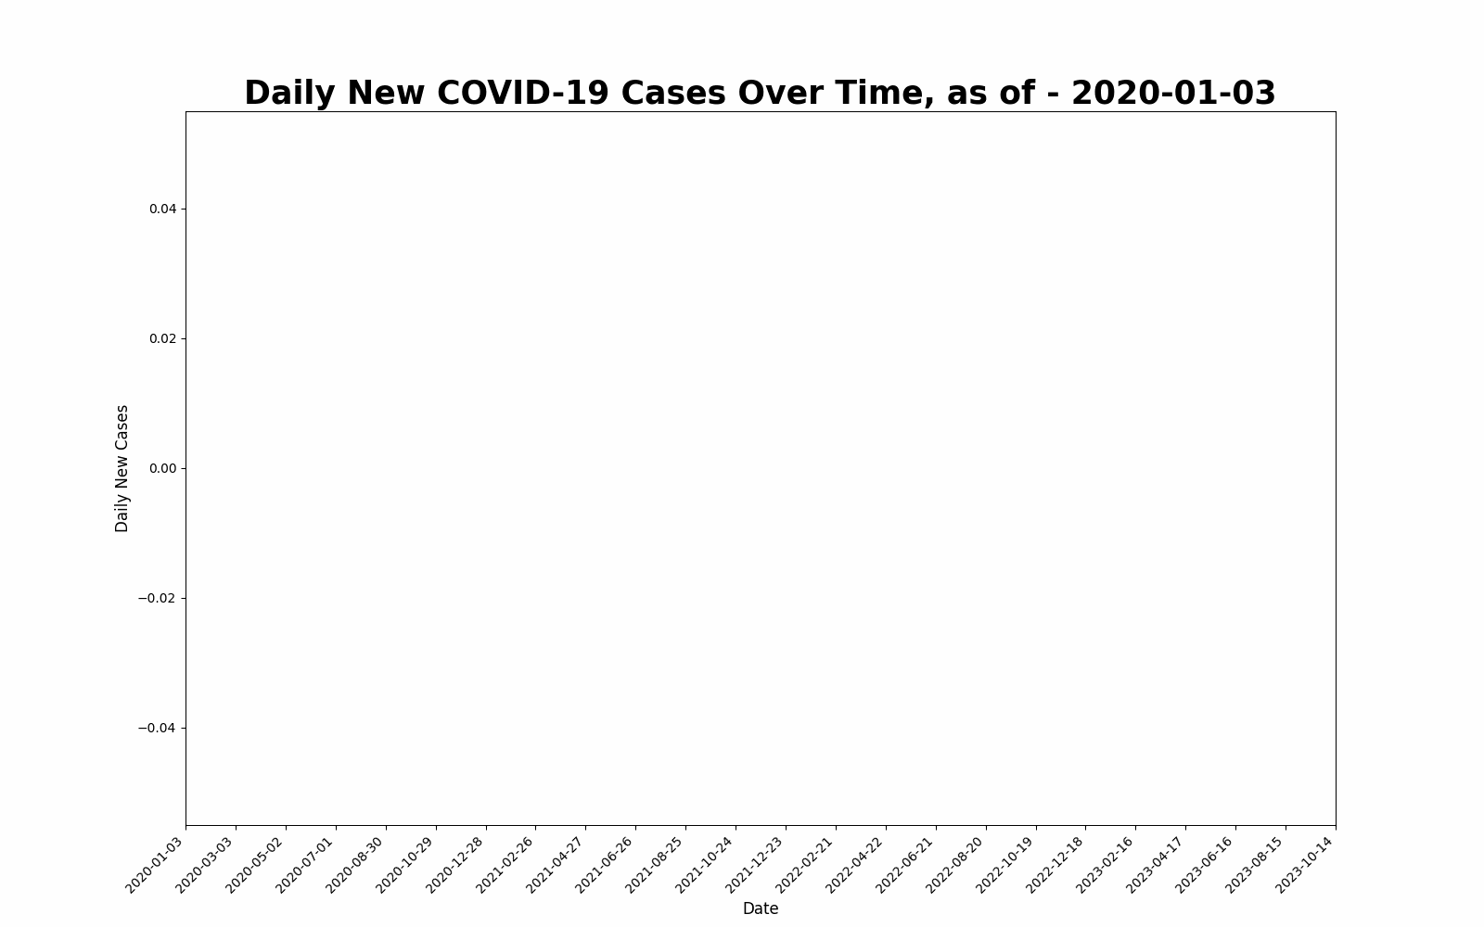
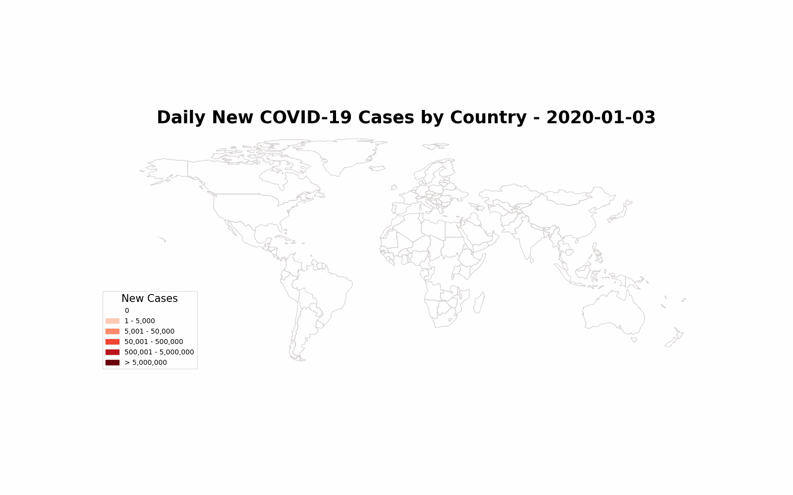

Slide 8
Main Takeaways and Findings
U.S. and China are the two countries that reported the most cases
The data is subject to reporting bias
Some countries (e.g., Australia, Russia) do not report new cases to WHO every day
Extreme case: Turkmenistan never reported to WHO
The data suggests a positive correlation between population size and total number of cases
The data shows no strong/direct correlation between population density and infection rate
Possible explanation: domestic policies, vaccinations, reporting bias, etc.

Slide 9
Thank you

